Slide 1

How to survive at computer?
Daniel Šerek

Slide 2
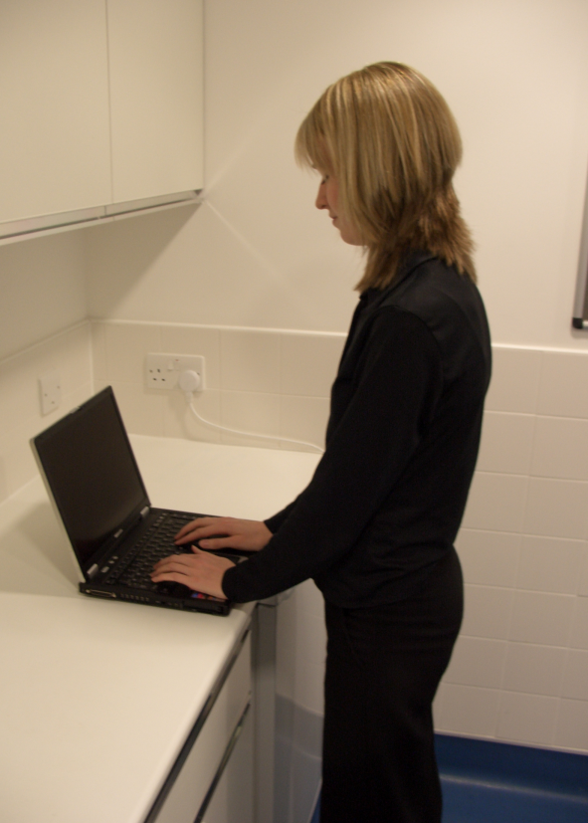
Workplace posture
What’s the best posture?

Slide 3
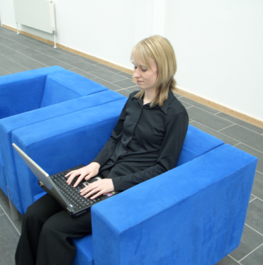



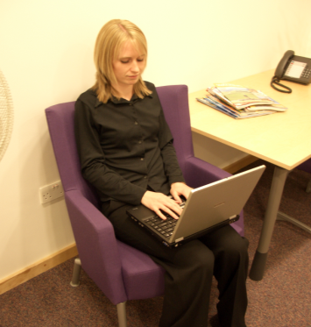
Workplace posture
…the next posture !

Slide 4
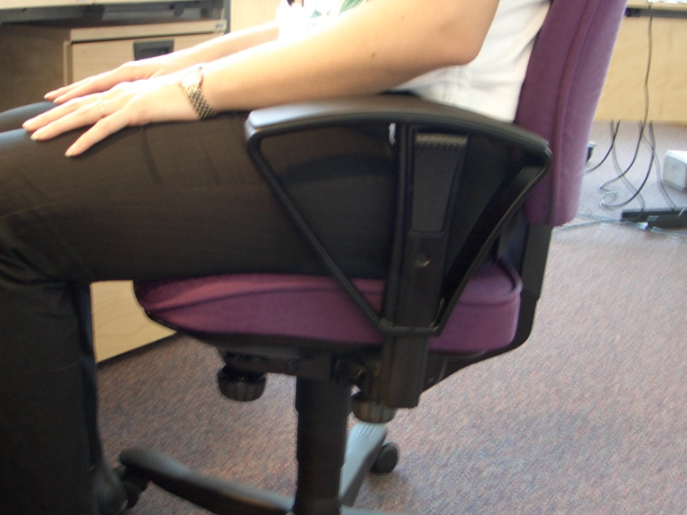
sit in the chair so that your buttocks and thighs are well supported – roughly even support at the front and rear of the thighs

Slide 5
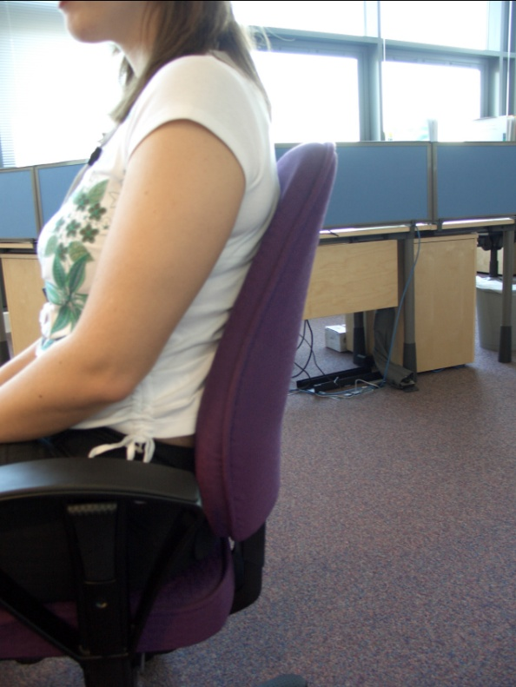

make sure your back is comfortably in contact with as much of the seat back as possible

Slide 6
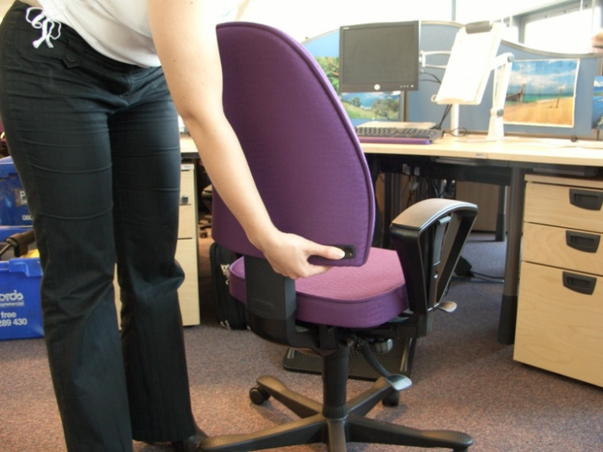
now adjust the seat back so that the lumbar support fits comfortably against your lumbar region
does the lumbar support adjust in height and in depth?

Slide 7
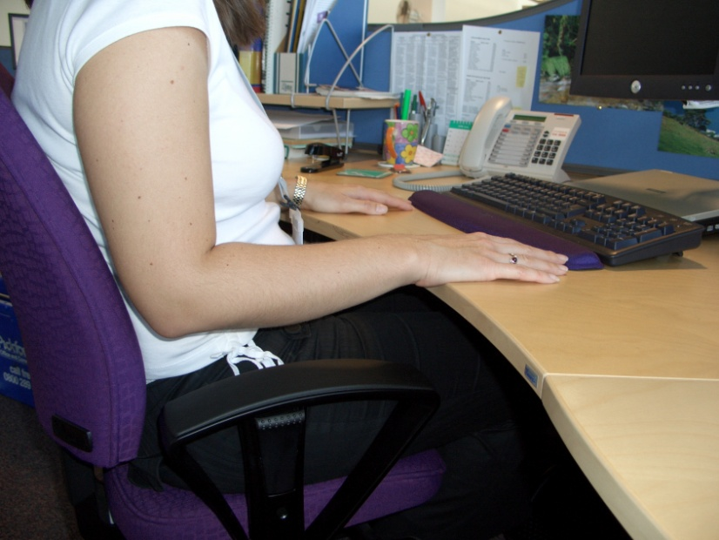
try and sit with your upper arms hanging vertical (straight down) and your forearms horizontal
aim for approximately 90 - 110°angle at the elbow

Slide 8
If the work desk is fixed height, adjust your seat height so that your elbows are at the same height as the middle row of your keyboard so that you can maintain a neutral wrist posture,

Slide 9
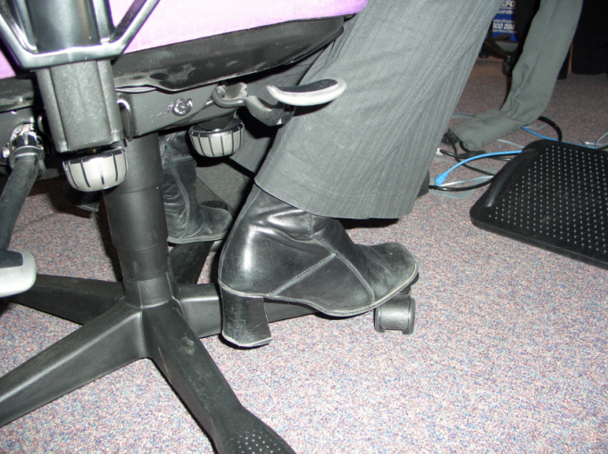
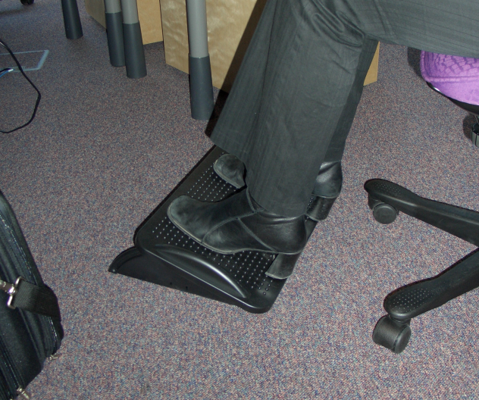
if you have raised your chair, your feet may no longer comfortably reach the floor; if this is the case, get a footrest

Slide 10
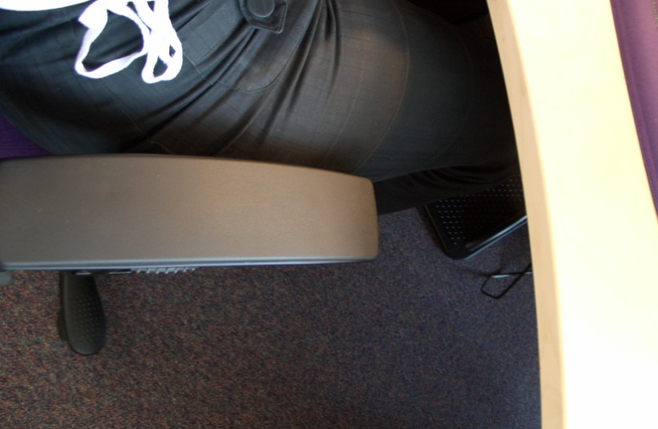
armrests can be useful for getting in and of the chair, but they may also ‘hit’ the desk and restrict your ability to get close enough to the desk…if this is the case, move them down and back, or have the armrests removed

Slide 11
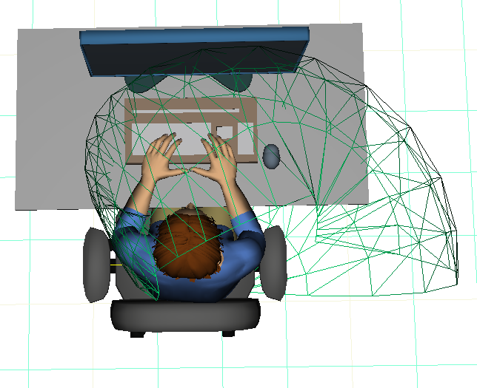
on to your monitor
the monitor should at arm’s length away
(this feels too close to some)

Slide 12
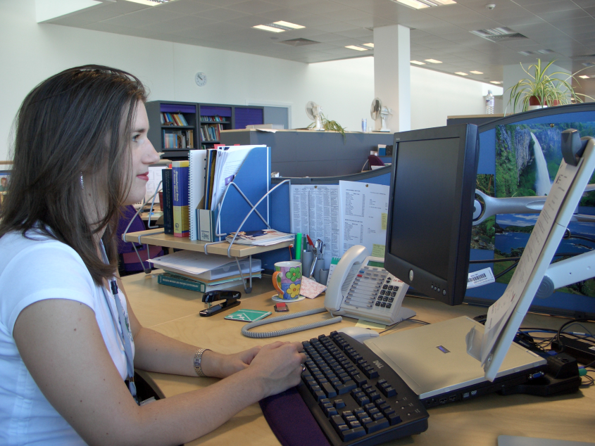
position the monitor so that the top part is no higher than your eyeline when your head is upright; top of screen in line with the eyes.
screen top should not be higher than eye height

Slide 13


if dual monitors are used equally, let them meet in the middle.
if one monitor is used 90% of the time, the ratio of offset should be approx 90% of the monitor’s width

Slide 14

leave some space in front of the bottom row of keys to rest your hands and arms when not keying

Slide 15
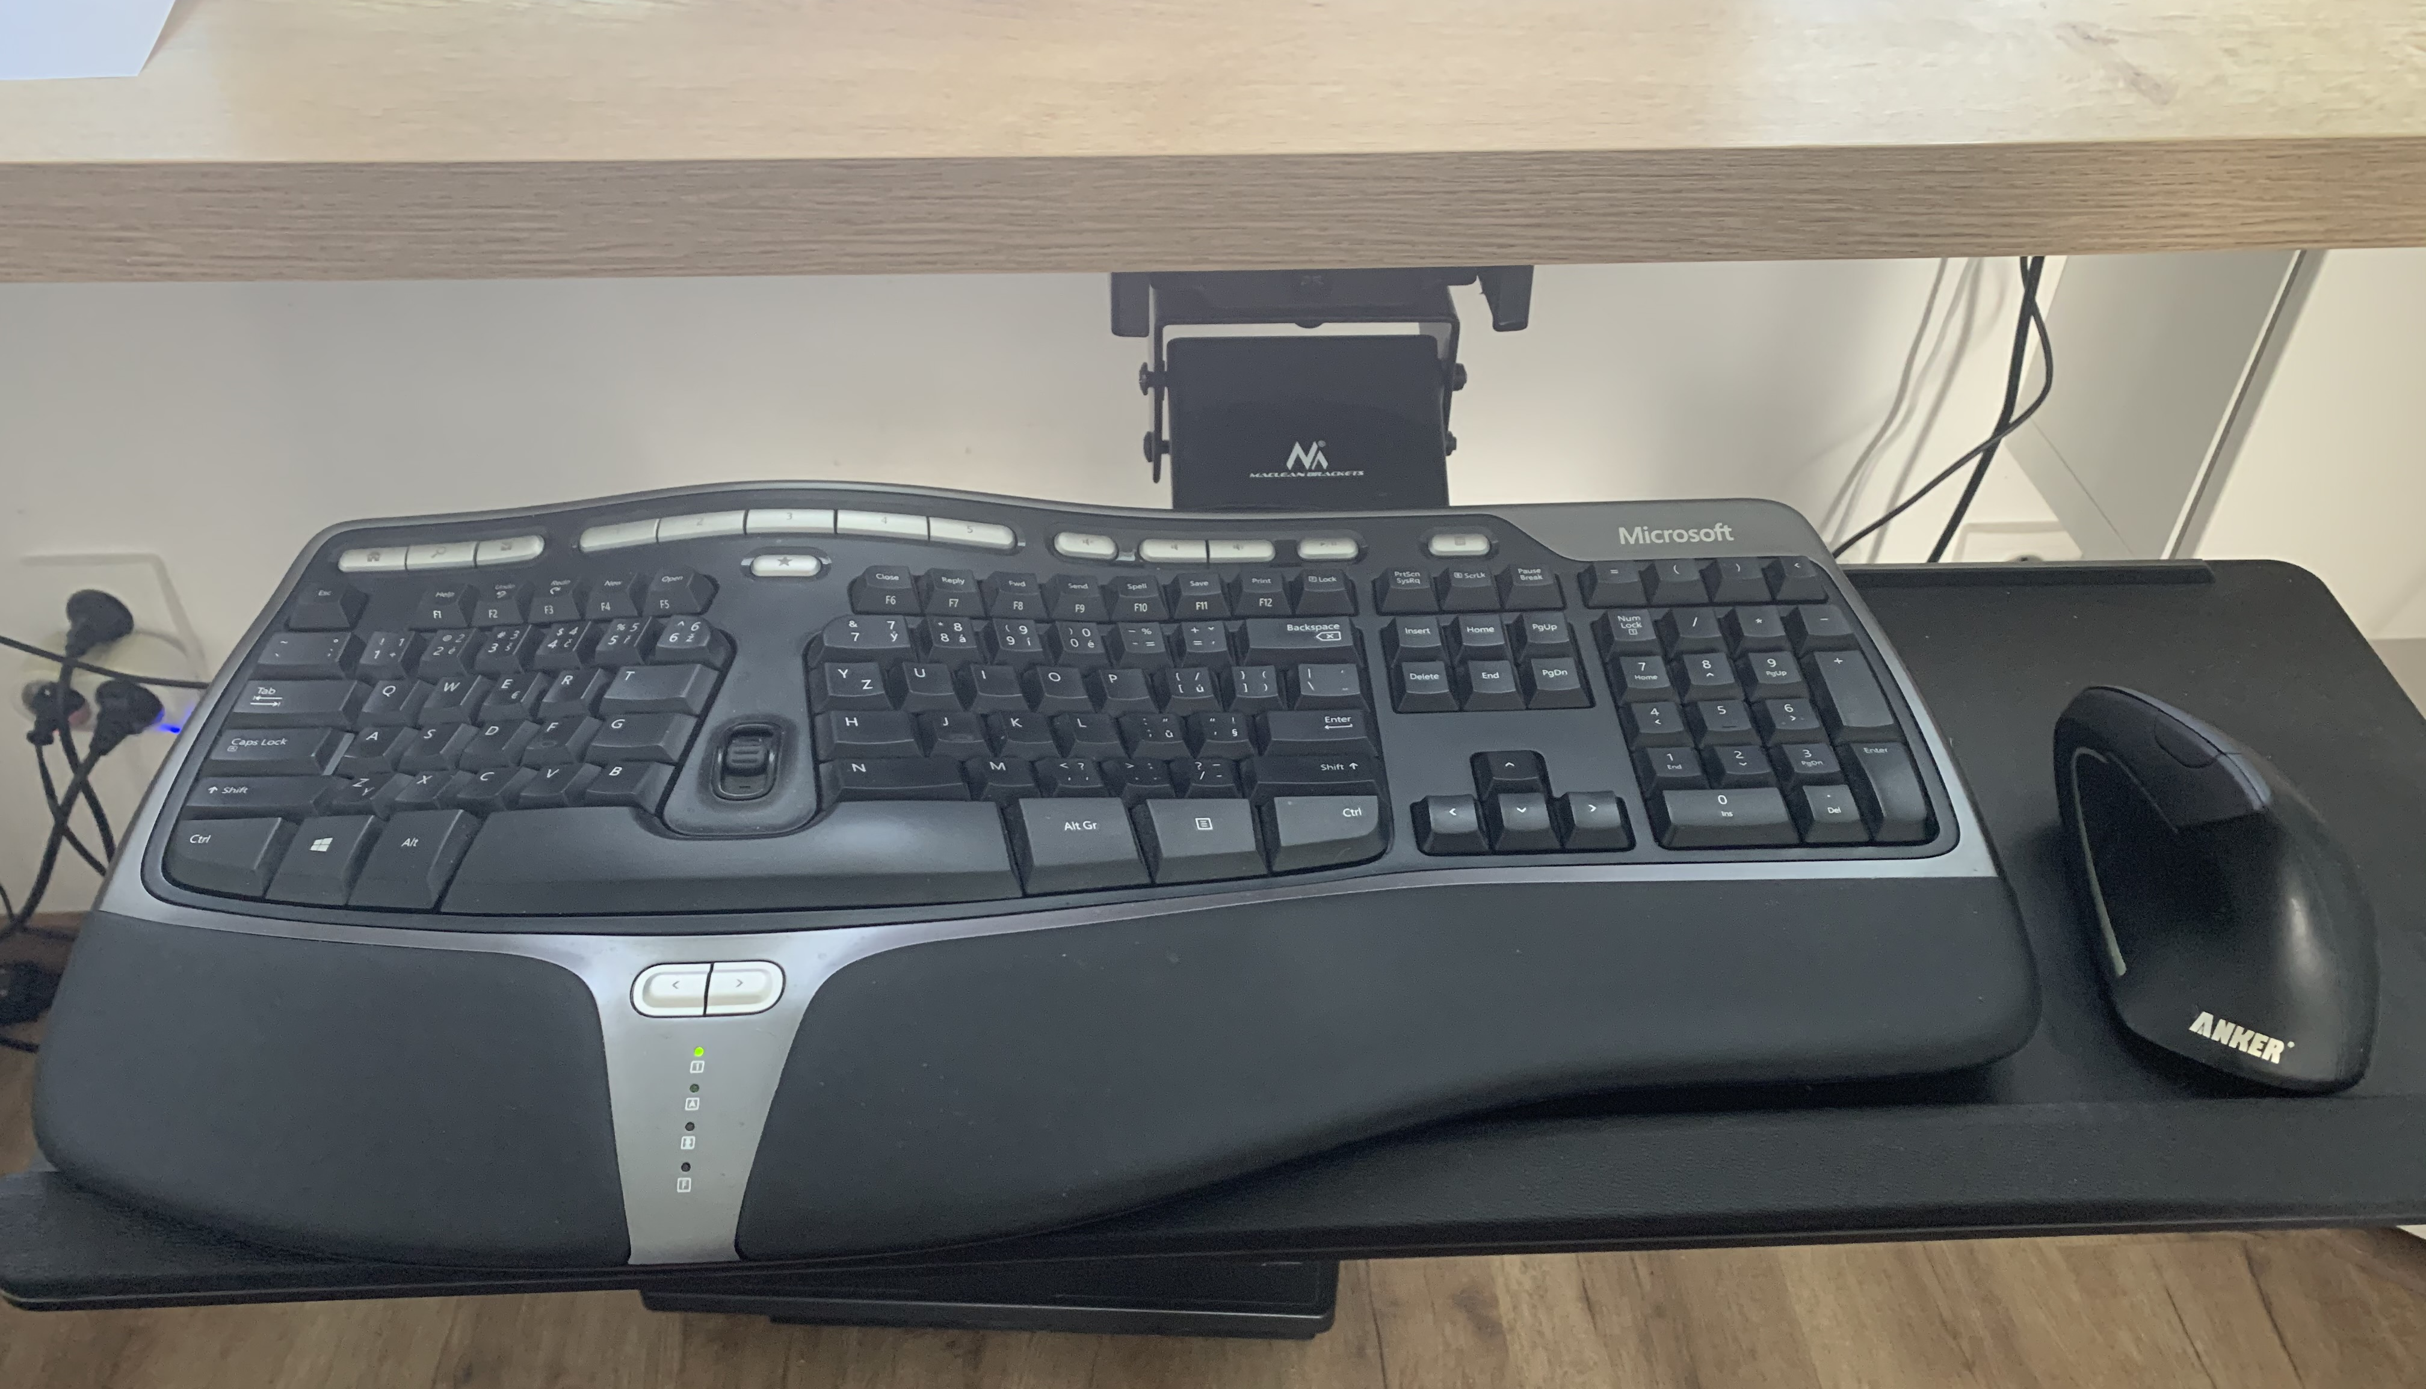

Slide 16
wrists rests are not essential, but actually do have health benefits. People should use one if recommended by a health professional or if you are used to having one.
the same applies to using ‘special ergonomic’ split keyboards

Slide 17
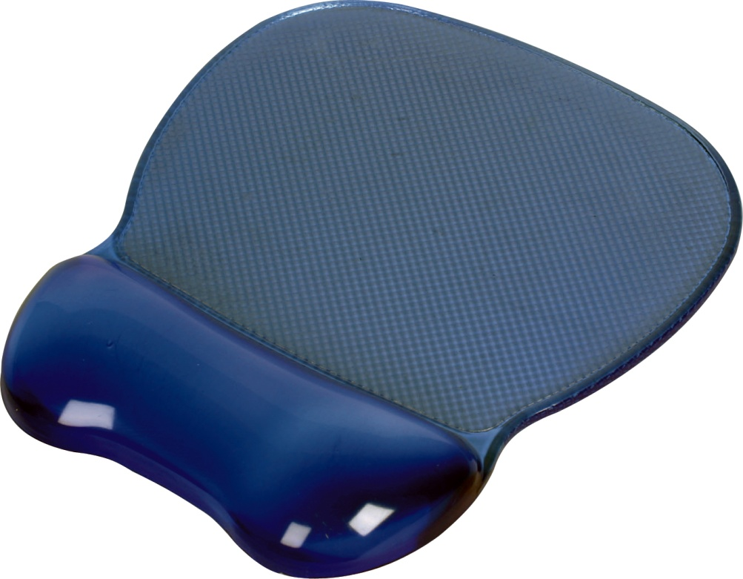

Could lead to:
compression of wrist
isolation of the wrist resulting in more ulnar radial deviation
Both are linked to increased prevalence of Carpal Tunnel Syndrome

Slide 18

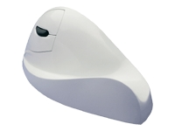

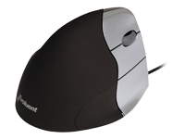
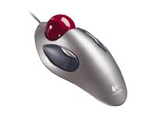
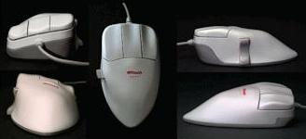

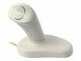

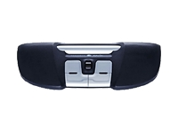



Slide 19
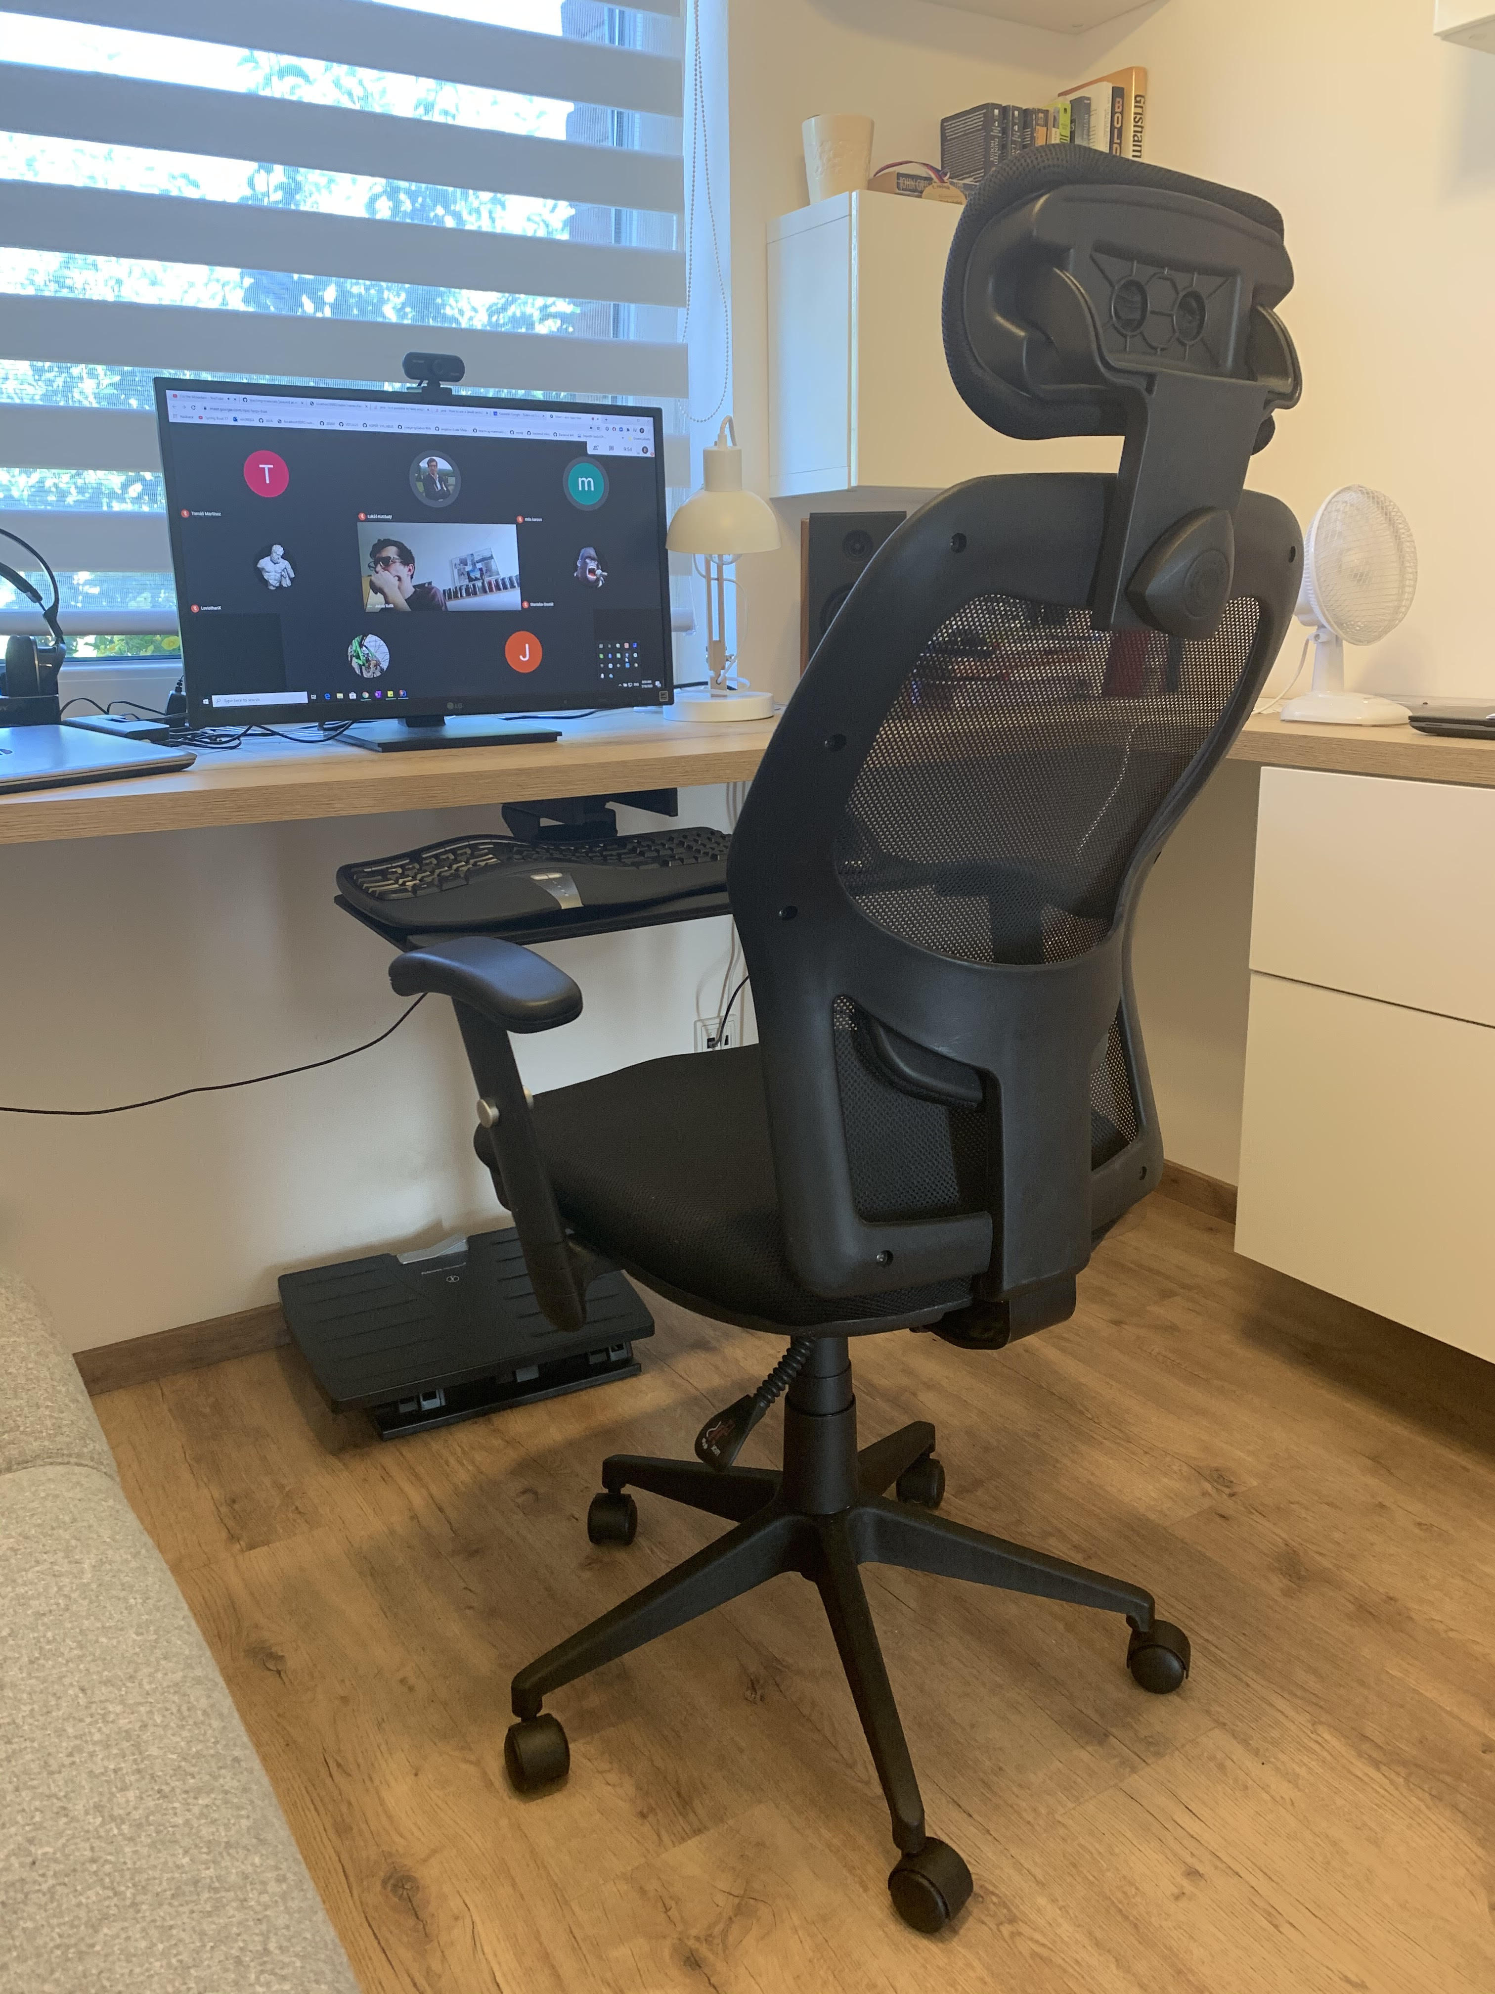
MY Workstation

Slide 20
Thank you!

